Slide 1
CROSS-PLATFORM
APPLICATION
DEVELOPMENT
TEAM - 6
G. Aishwarya -2021SP93074
Sharadhi-2021SP93034
Pragti Singh-2021SP93061
Pratyush Sinha-2021SP93070
Mohit M-2021SP93069

Slide 2
PROBLEM STATEMENT
Do any of the following seem familiar?
You often feel completely overwhelmed with the amount of work
you’ve got to do?
You sometimes forget to do things that are important
People have to chase you to get things done
You find it a struggle to keep to deadlines
Don’t think you’re unusual because there are thousands of students or
in general say people who struggle with.

Slide 3

SOLUTION
CONNECT is the go-to app that helps one to add a task based on a particular category. It also helps you track what tasks are to be done and by when they should be submitted.
It helps in reminding the deadlines and connecting with people who are involved in the task and work on it collaboratively.

Slide 4
FEATURES
Sign-in/Sign-up
Keep track of tasks
Categorize the tasks
Creating tasks based on categories
Chatting with team members
Remainders of the deadlines

Slide 5
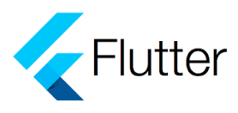
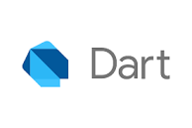
FRONT END
FLUTTER: Flutter is an open-source mobile UI framework created by Google which allows us to develop cross platform applications
DART : Dart is a programming language designed for client development, such as for the web and mobile apps. It is developed by Google and can also be used to build server and desktop applications.

Slide 6
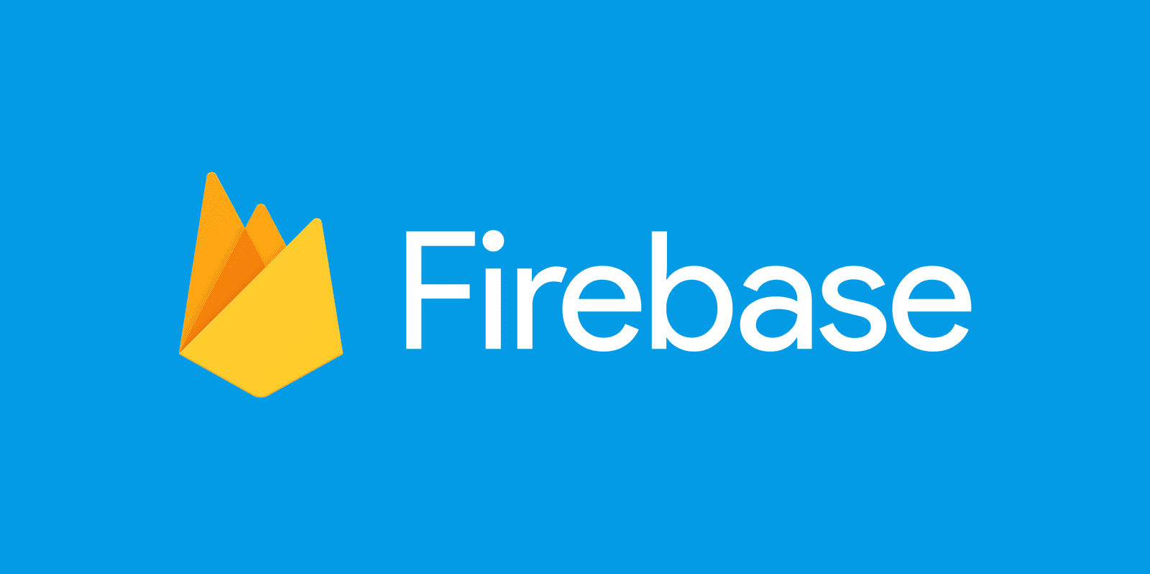
BACKEND
FIREBASE: Firebase is a set of hosting services for any type of application (Android, iOS, JavaScript, Node.js, Java, Unity, PHP, C++..). It is a platform developed by Google for creating mobile and web applications

Slide 7
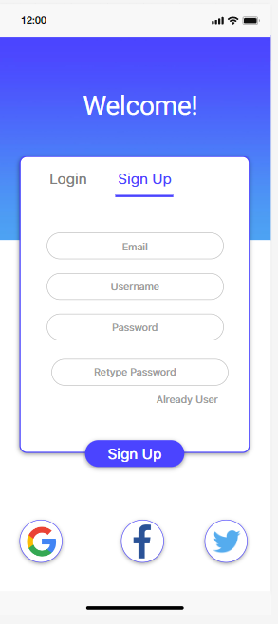
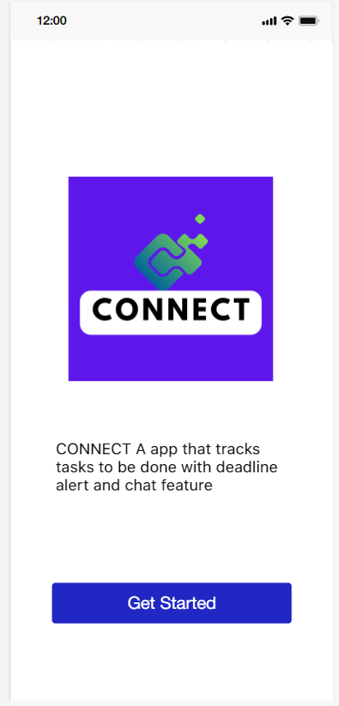
MOCK UI
(1) Welcome or Landing Page
(2) Sign Up Page

Slide 8
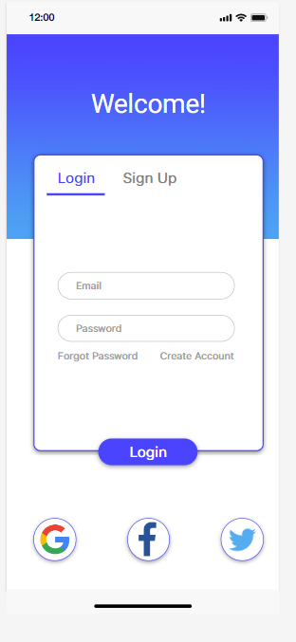
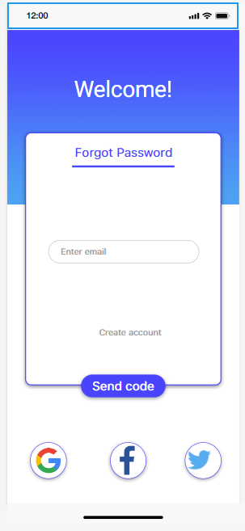
MOCK UI(Continued…)
(3) Login Page
(4) Forgot Password Page

Slide 9
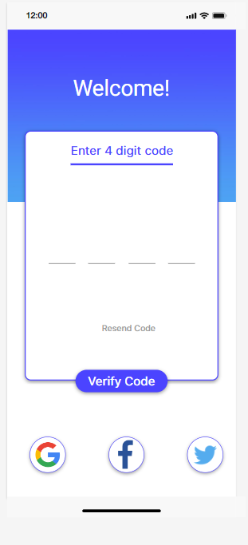
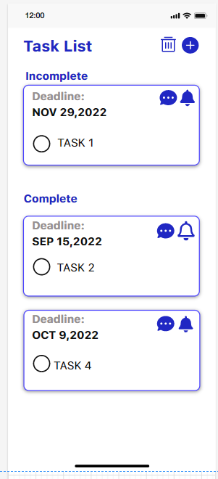
MOCK UI(Continued…)
(5)Authentication Page
(6) Task List Landing Page

Slide 10
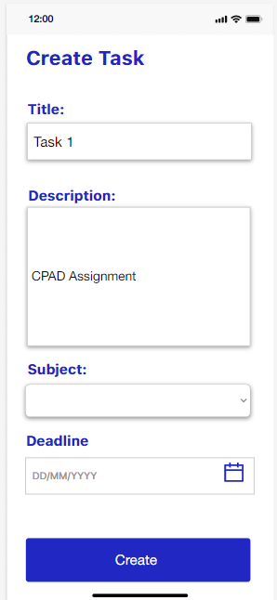
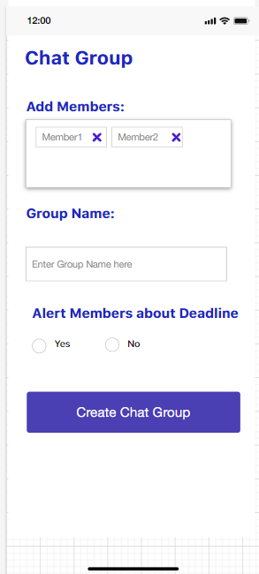
MOCK UI(Continued…)
(7) On Click of Create Task button Create Task Page Opens Up
(8) Create New Chat Group Page

Slide 11
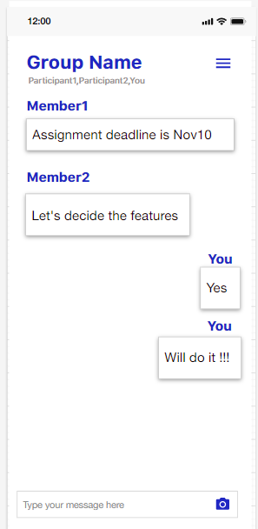
MOCK UI(Continued…)
(10)Group Chat Page

Slide 12
THANK YOU

